Slide 1





IDENTIFYING SUICIDAL TENDENCY AMONG YOUNG STUDENTS OF BANGLADESH USING MACHINE LEARNING

Slide 2
”DON'T BE SAD😞”
“ENJOY YOUR LIFE.😊”

Slide 3
OVERVIEW
Future work and Conclusion
Objective
Methodology
2
4
6
1
3
5
Introduction
Data Description
Performance Analysis

Slide 4
INTRODUCTION
The thesis proposes a machine learning approach for Identifying Suicidal Tendency among Young Students of Bangladesh Using Machine Learning. The approach involves collecting data on student characteristics and behaviours, preprocessing and engineering the data to create features suitable for machine learning, evaluating various machine learning models, and deploying the best-performing model to a production environment. This could lead to earlier intervention and prevention of suicide, which would save lives.

Slide 5
OBJECTIVE
Develop a machine learning model that can analyze patterns and identify potential signs of suicidal tendencies in young students based on their online activities, such as social media posts, search history, and online interactions.
01 - DEVELOP
Collect and analyze a comprehensive dataset consisting of various factors related to mental health, such as depression symptoms, anxiety levels, stressors, and previous history of self-harm or suicidal ideation among young students in Bangladesh.
02 - COLLECT
Explore different machine learning algorithms, such as decision trees, logistic regression, or support vector machines, to build a predictive model that can accurately detect and classify young students at risk of suicidal tendencies.
03 - EXPLORE

Slide 6
OBJECTIVE
Collaborate with mental health professionals, educators, and counsellors to incorporate their expertise and domain knowledge into the model development process, ensuring the inclusion of relevant features and validation of the results.
04 - COLLABORATE
Evaluate the machine learning model’s performance using appropriate metrics, such as accuracy, precision, recall, and F1 score, to measure its effectiveness in identifying and predicting suicidal tendencies among young students.
05 - EVALUATE

Slide 7
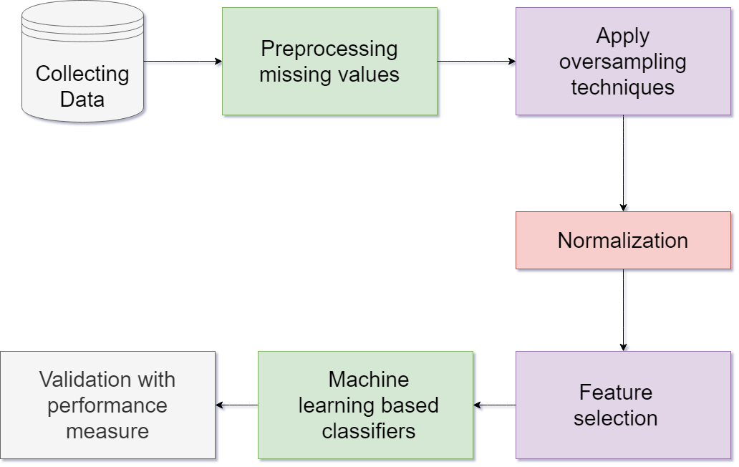
BLOCK DIAGRAM

Slide 8
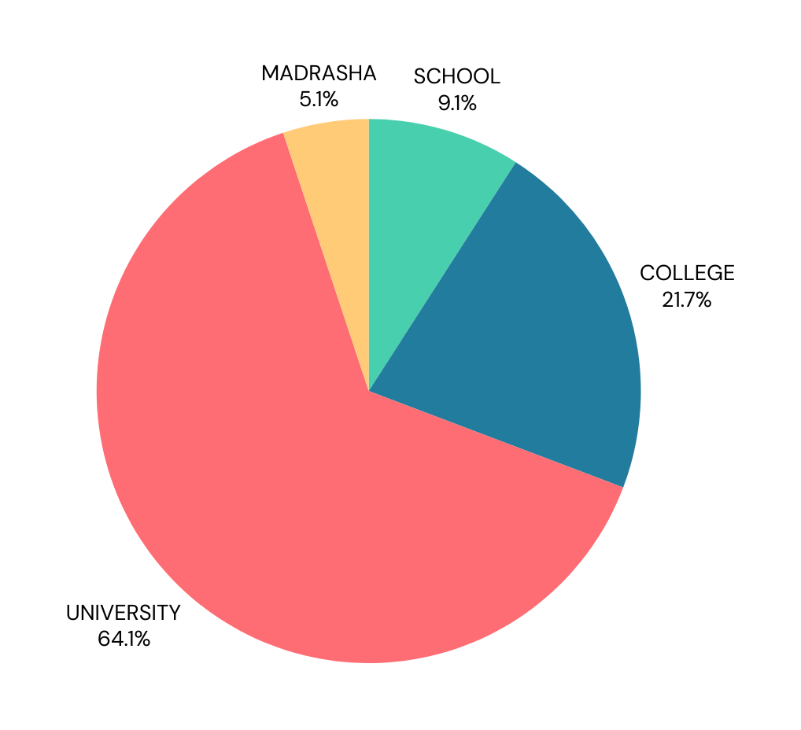
DATA COLLECTION
SCHOOL
MADRASHA
We collected 5.1% data from Madrasha Students.
We collected 9.1% data from Schools Students.
UNIVERSITY
COLLEGE
We collected 64.1% data from University Students.
We collected 21.7% data from College Students.

Slide 9
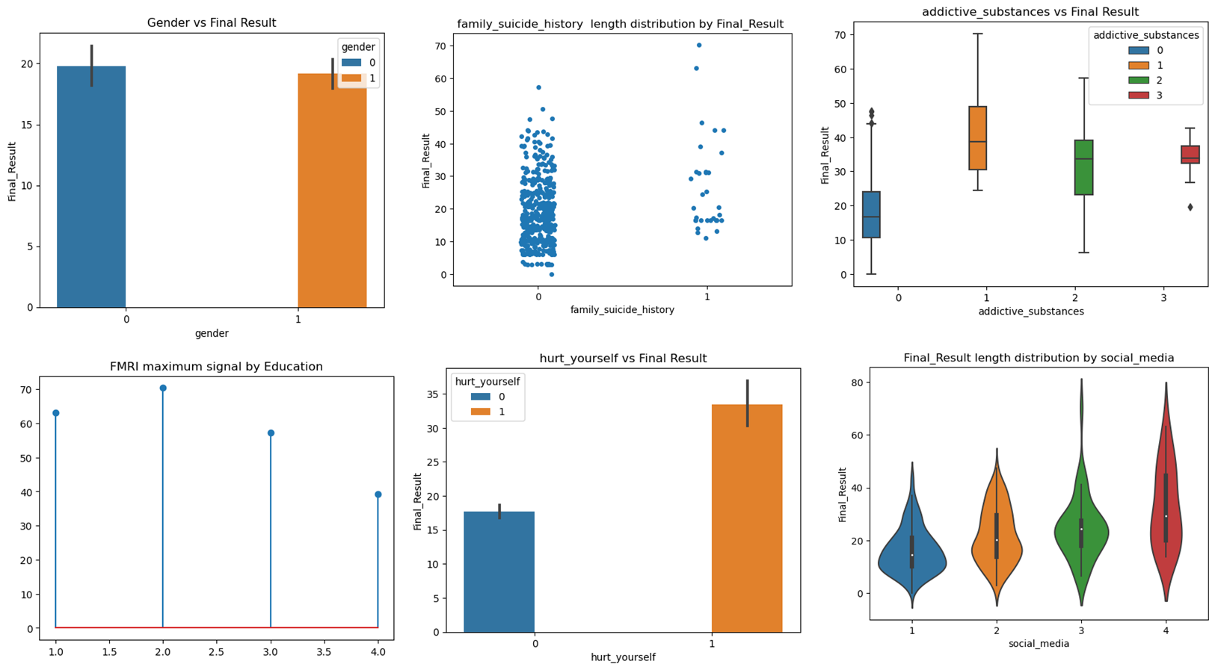
DATA ANALYSIS

Slide 10
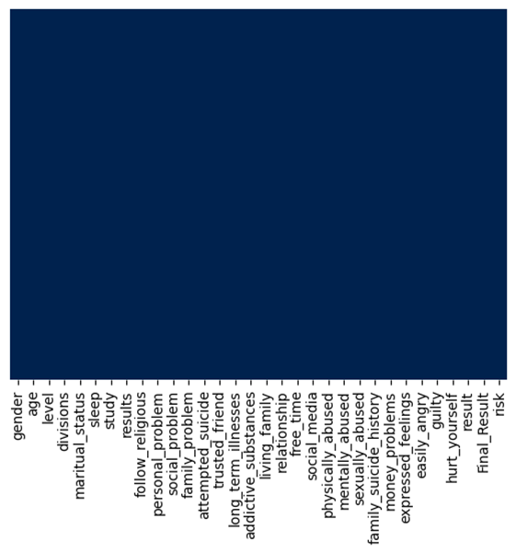
DATA CLEANING
• Impute the missing values with the column’s mean, median, or mode.
• Drop the rows with missing values.
• Use a machine learning model to predict the missing values like isnull()

Slide 11
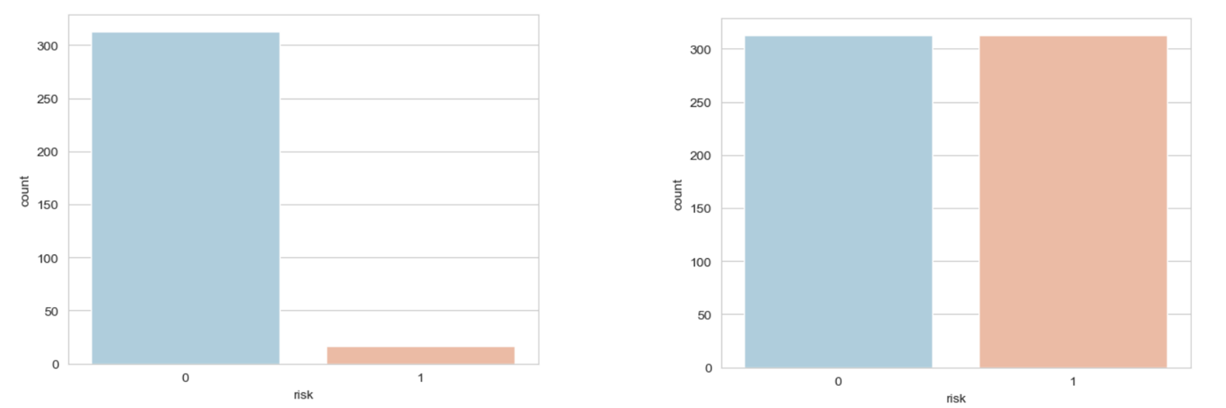
NORMALIZE THE DATA AND OVERSAMPLING
Normalization is scaling the data so that all features have similar values. This can improve the performance of machine learning models by making the parts more comparable.

Slide 12
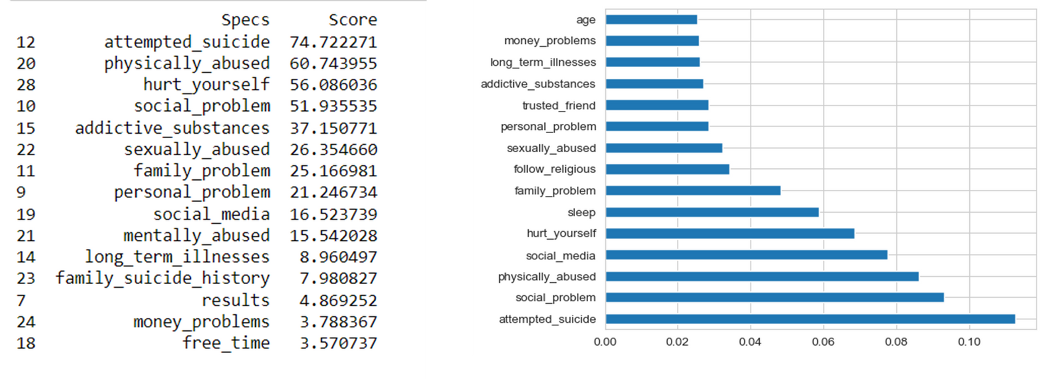
FEATURE SELECTION

Slide 13
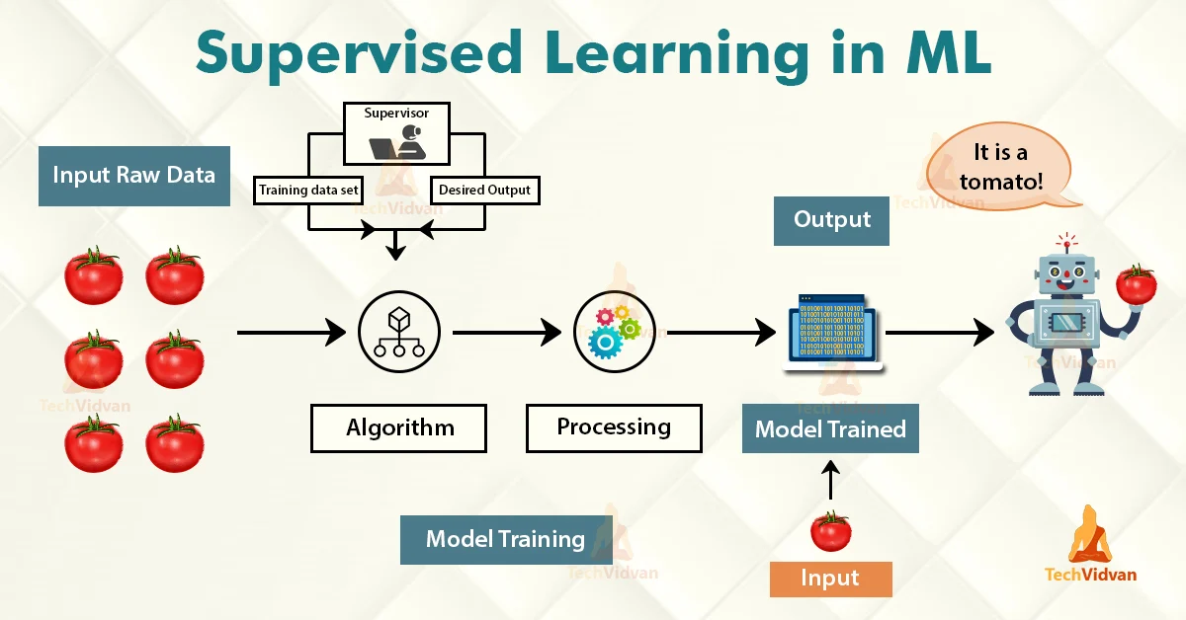

Slide 14
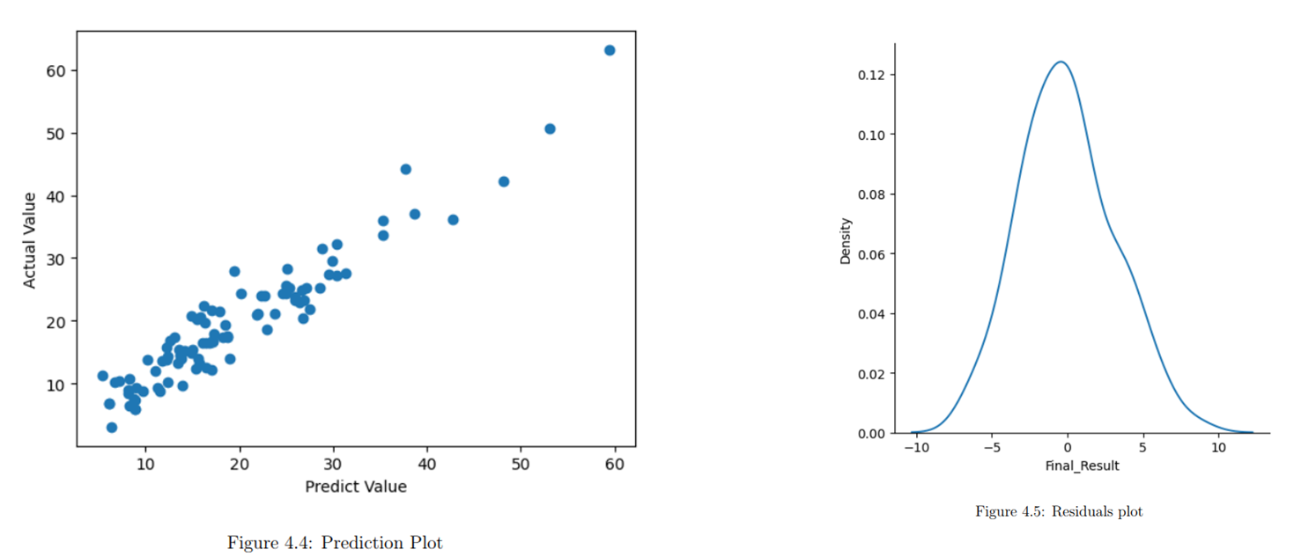
PERFORMANCE ANALYSIS

Slide 15
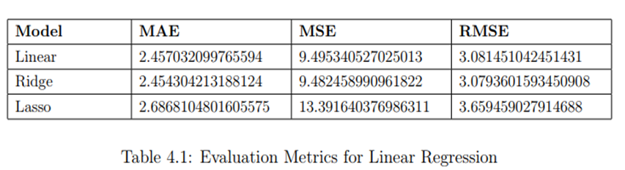
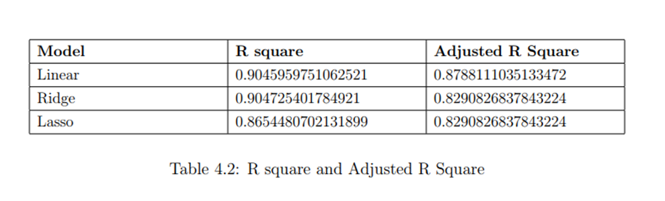
PERFORMANCE ANALYSIS

Slide 16
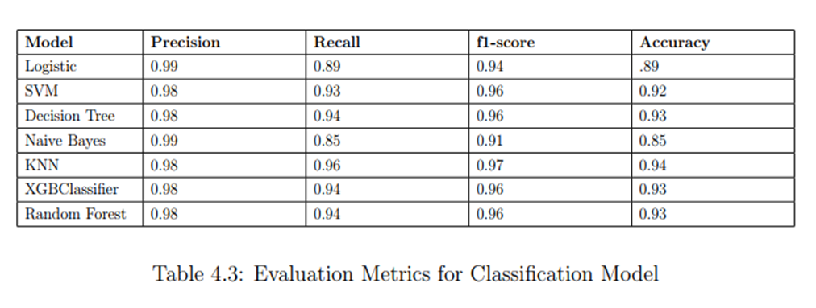
CLASSIFIER ANALYSIS

Slide 17
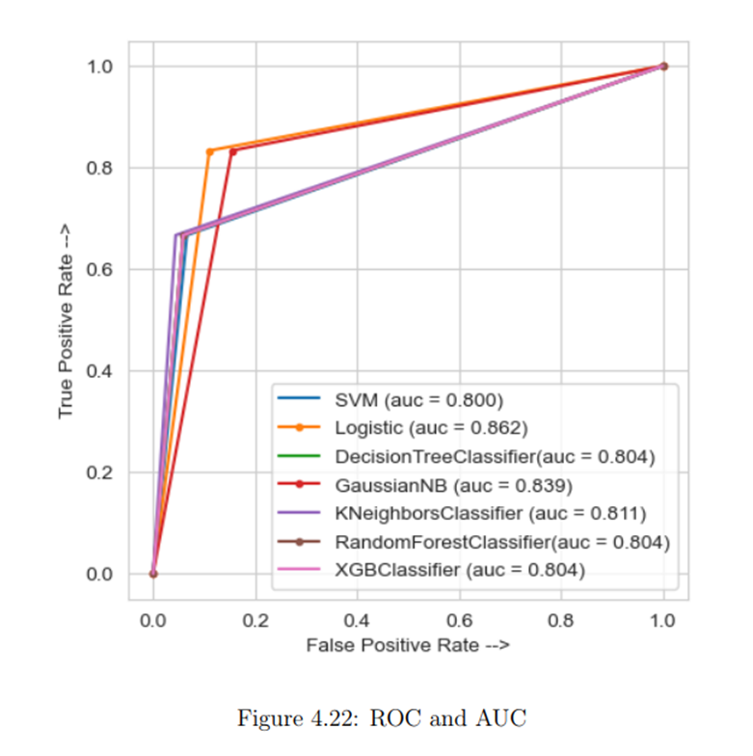
CLASSIFIER ANALYSIS

Slide 18
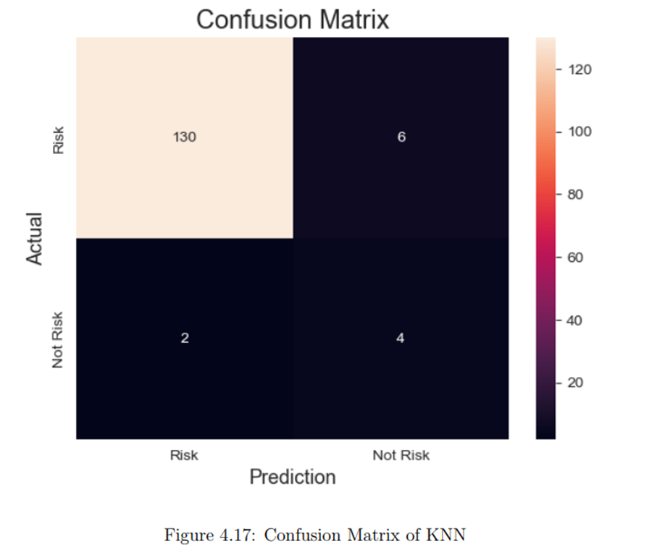
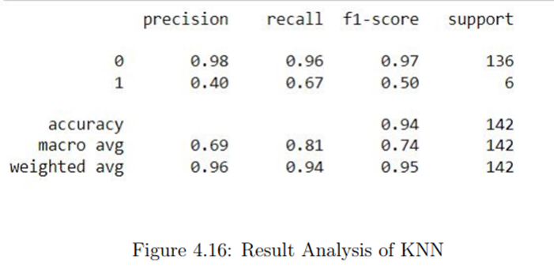
BEST MODEL

Slide 19
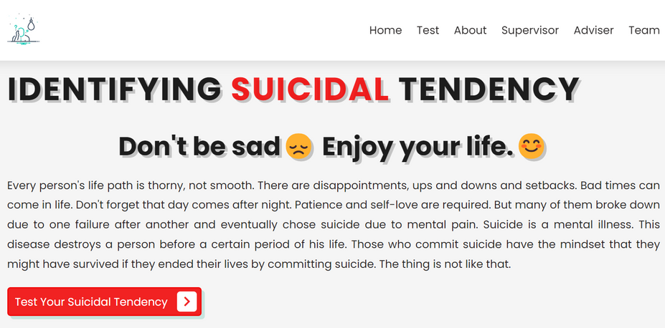
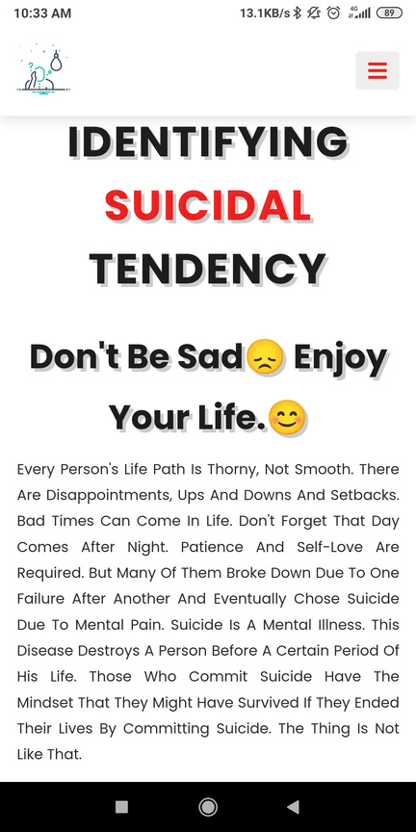
DEPLOYMENTS
WEBSITE
APP

Slide 20
CONCLUSION
To determine important factors that contribute to young students’ resistance to suicidal thoughts and actions or risk factors for suicide, this study used a data-driven paradigm. Numerous factors that can be changed turned out to be significant corre- lations of STBs. Future research should look at whether programmes that encourage participation in worthwhile, fulfilling, and enjoyable activities also strengthen social bonds, boost wellbeing, and lessen the intensity of suicidal thoughts and actions in student populations

Slide 21
FUTURE WORK
Longitudinal Studies: Collect data over time to understand how risk factors evolve and predict future suicide attempts.
Social Media Data: Explore the potential of analyzing anonymized social media data for early signs of suicidal ideation.
Deep Learning Techniques: Explore using deep learning architectures to handle complex relationships between risk factors.
Explainable AI: Implement techniques to understand why the model identifies certain students as high-risk, increasing transparency and trust.

Slide 22
THANK YOU

